Slide 1
Analysis of AIRBNB DATA USING POWER BI
SAMIR SHANKAR JADHAV

Slide 2
AIRBNB DATA ANALYSIS:
BUSINESS UNDERSTANDING:
The main objective is to analyze Airbnb data to reveal insights into user experiences and satisfaction levels with numerous listed stays.
DATA UNDERSTANDING/PROJECT GOALS:
Assessing District location scores
Examining Host Response Time Impact
Visualizing Airbnb Listing Prices
Analyzing Composite Scores
Calculating Listing Age and Host Tenure
Property Type Price Analysis
Comprehensive City Insight Report

Slide 3
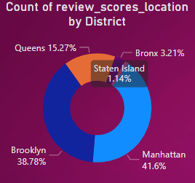
ASSESSINING DISTRICT LOCATION SCORES:
The location in the District with least favorable location scores are Bronx and Staten Island with a percent share of 3.21 and 1.14 %.

Slide 4
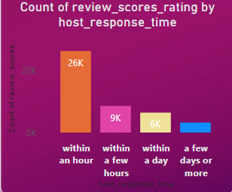
EXAMINING HOST RESPONSE TIME IMPACT:
Most of the visitors queries were catered to well within an hour with a count of 26K
The host response time of few hours was closely followed to that within an hour with a count score of 9K

Slide 5
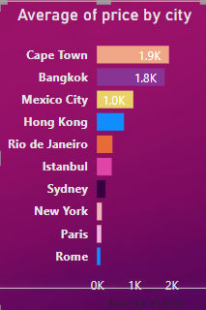
VISUALIZING AIRBNB LISTING PRICES:
The average prices listed in Cape Town was the highest followed by Bangkok and Mexico City.
The prices were least in Rome.

Slide 6
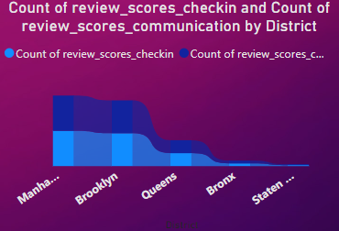
ANALYZING COMPOSITE SCORES:
The composite scores of checkin experience and host communication was found to be high in Manhattan followed by Brooklyn
The composite score was the least for Bronx and Staten Island.

Slide 7
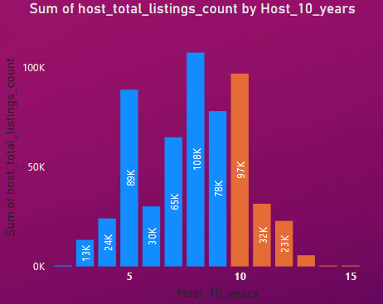
CALCULATING LISTING AGE AND HOST TENURE:
There is a gradual decrease in the age of the Airbnb listing host who have accumulated more than ten years of hosting experience.

Slide 8
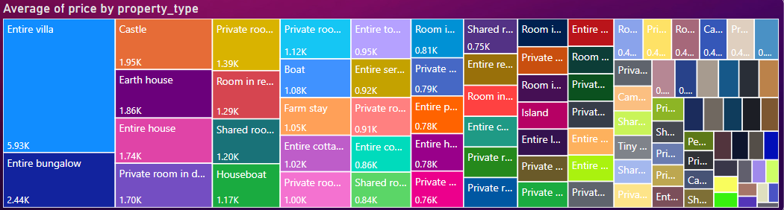
PROPERTY TYPE PRICE ANALYSIS:
The average price for various rooms and property types was found to be highest for Entire Villa with the average price being $5926.6.
The least price was in property type: Shared room in serviced apartment with an average price of $43 .

Slide 9
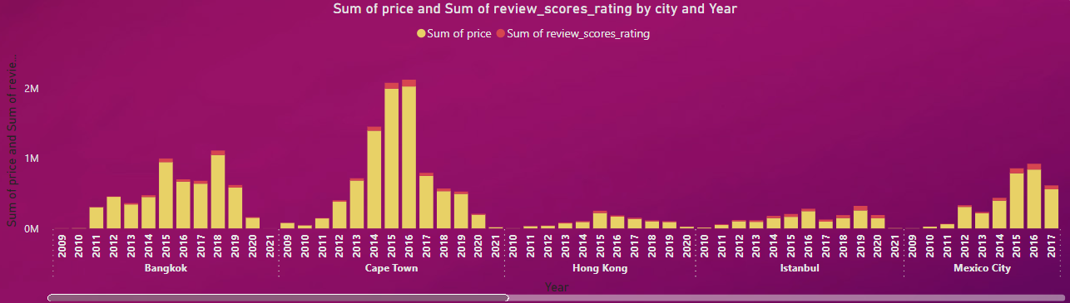
COMPREHENSIVE CITY INSIGHTS REPORT:
In the following diagram listing prices, guest ratings and visitor trends for multiple cities are plotted.
Listing prices were very high in Bangkok and Cape Town in earlier years as contrast to year 2020.
While in rest of the cities the Listing prices were average in earlier years as contrast to year 2020.

Slide 10
THANK YOU !

